Slide 1
Trees and Random Forest
Data Bootcamp 2017
INFORMS@USF

Slide 2
Classification and Regression Trees (CART)
Classification and regression trees are machine-learning methods for constructing prediction models from data.
The models are obtained by recursively partitioning the data space and fitting a simple prediction model within each partition.
As a result, the partitioning can be represented graphically as a decision tree.

Slide 3
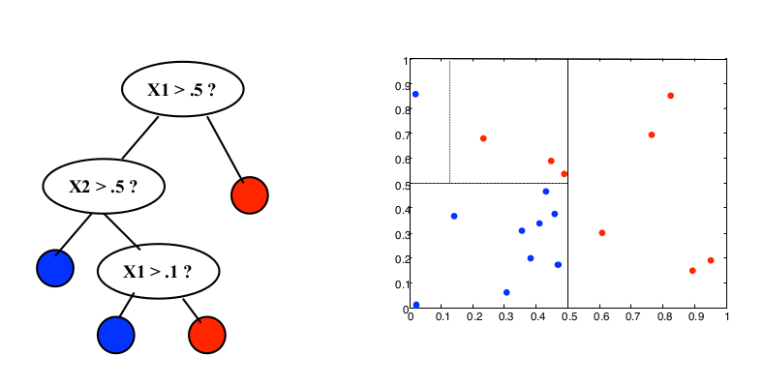
Classification Trees
X2
No
Yes
X1

Slide 4
1. Grow a tree
rpart(formula, data=, method=,control=) where
formula | is in the format outcome ~ predictor1+predictor2+predictor3+ect.
data= | specifies the data frame
method= | "class" for a classification tree "anova" for a regression tree
control= | optional parameters. For example, control=rpart.control(minsplit=30, cp=0.001) requires that the minimum number of observations in a node be 30 before attempting a split and that a split must decrease the overall lack of fit by a factor of 0.001 (cost complexity factor) before being attempted.

Slide 5
2. Plot
Option 1 | plot() | plot decision tree
 | text() | label the decision tree plot
Option 2 | prp() | Plot decision tree using rpart.plot package

Slide 6
Practice before evaluation
Predict the result of the following observations:
Survived | Pclass | Sex | Age | SibSp | Parch | Fare | Embarked
1 | 2 | female | 55 | 0 | 0 | 16 | S
0 | 1 | male | 28 | 1 | 0 | 82.1708 | C

Slide 7
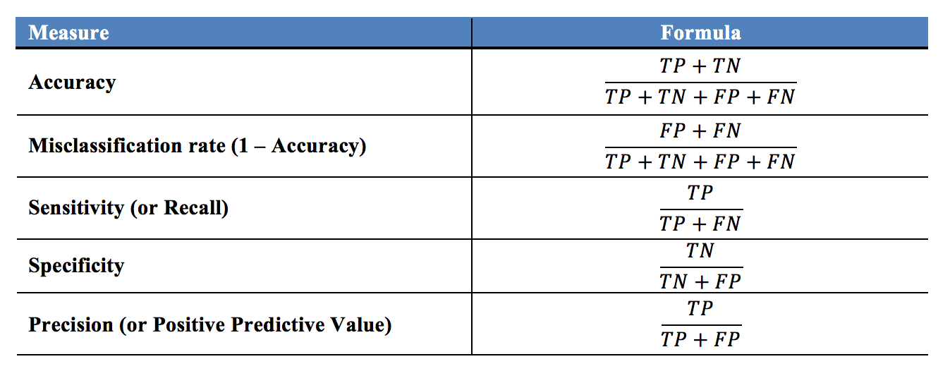
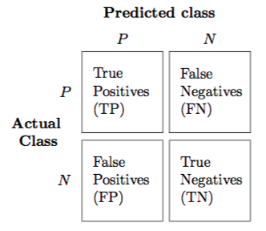
3. Evaluation
predict(tree object, newdata= , type="class")

Slide 8
Random Forest
install.packages("randomForest")
library(randomForest)
The response variable must be factors in classification problems
randomForest(Survived~Pclass+Sex+Age+SibSp+Parch+Fare+Embarked,data=Train2, nodesize=10,ntree=2000)
Evaluate

